Slide 1
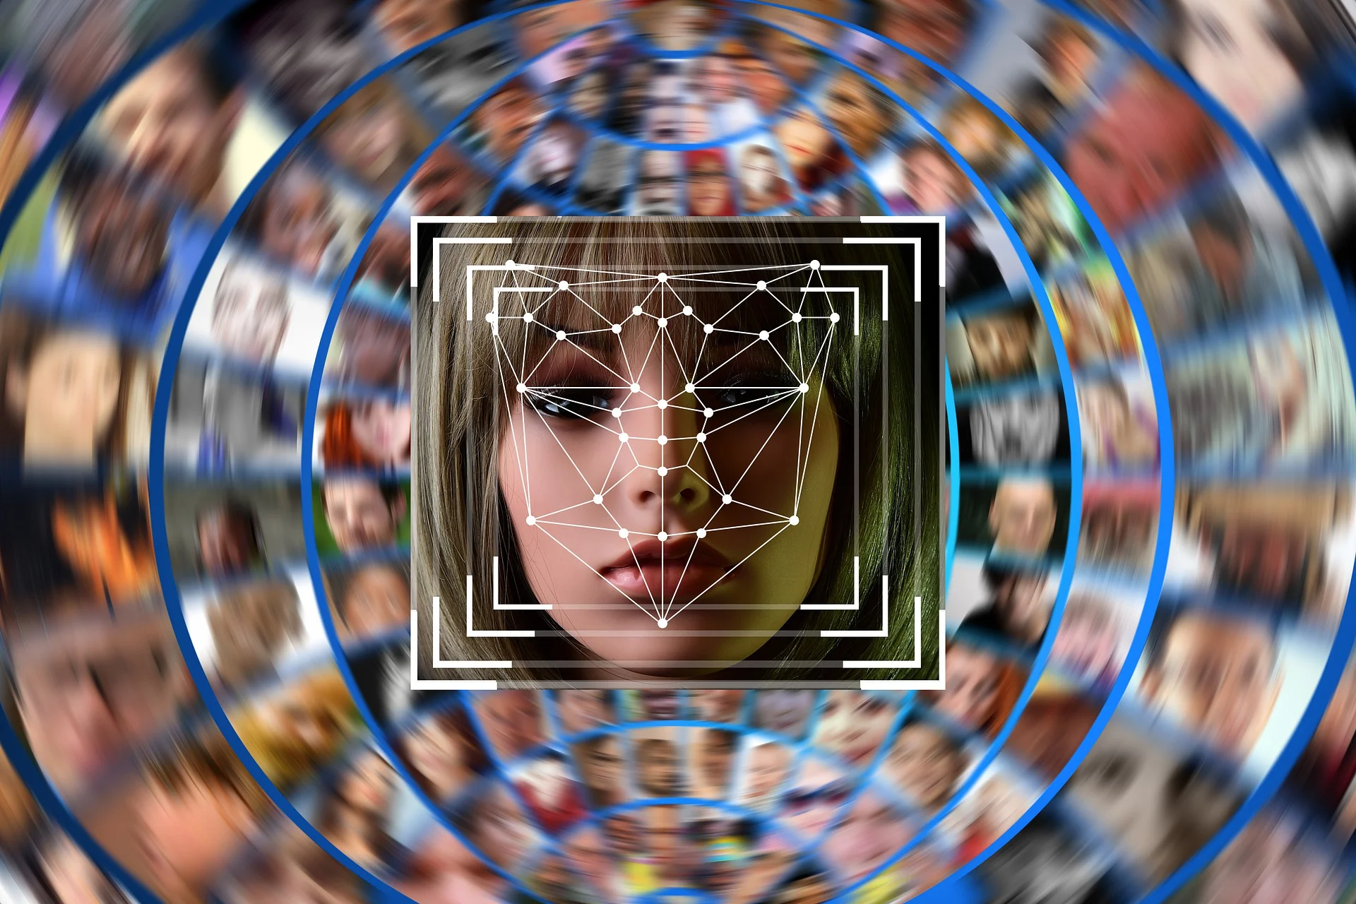
Facebook's Face Recognition

Slide 2
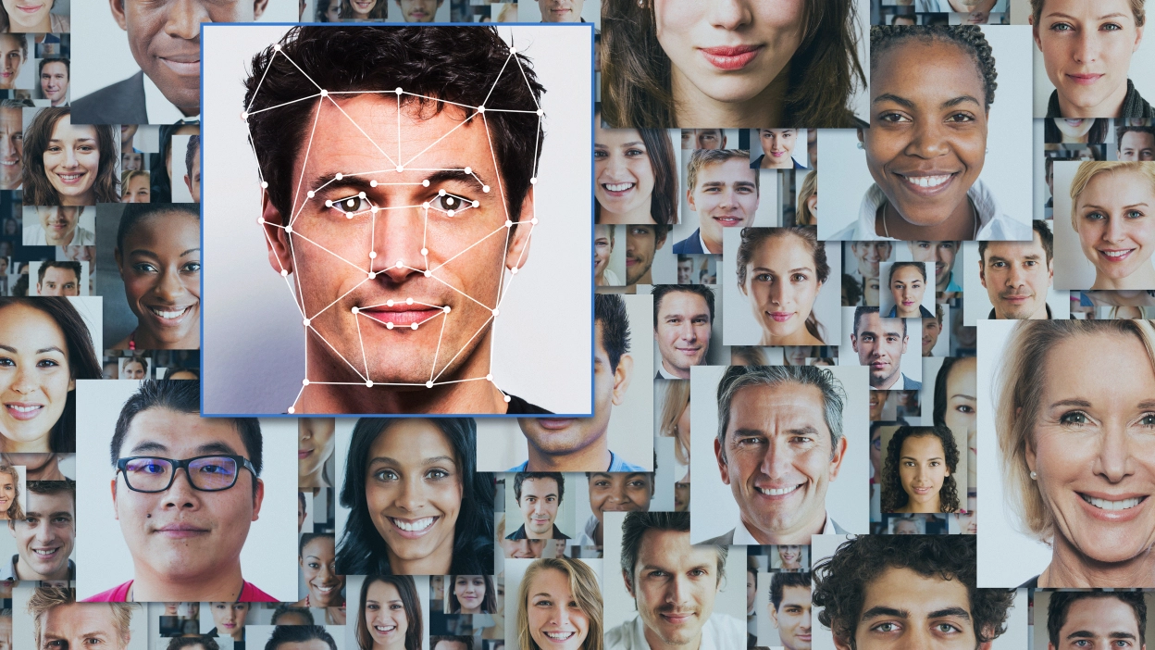
Labeled Faces in
the Wild (LFW)

Slide 3

Human
97.53 %
Software
97.25 %

Slide 4


Slide 5
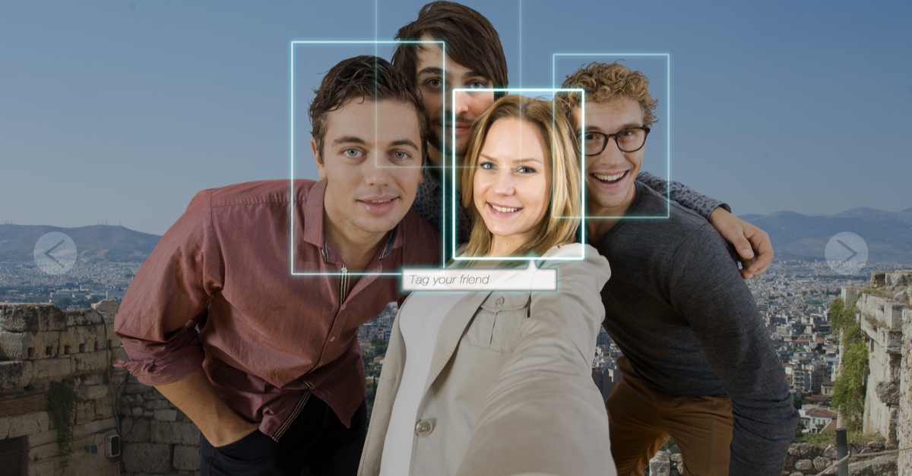

Slide 6
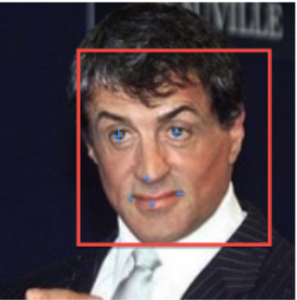

DeepFace
(Phase 1)

Slide 7
6-fiducial points

Slide 8
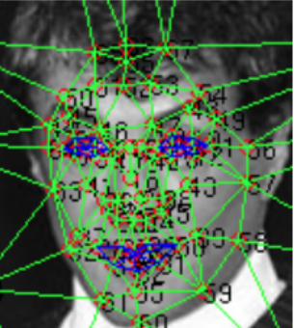
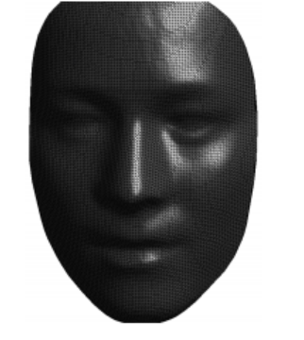
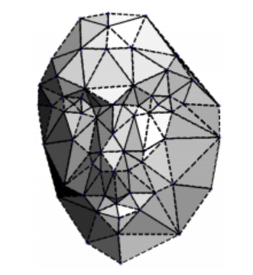
3D shape generated from the align
2D-crop image
Visibility map of 2D shape in 3D
(darker triangles are less visible
as compared to light triangles)
67 fiducial points with Delaunay
triangulation

Slide 9
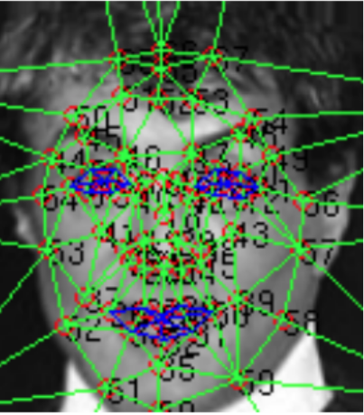
67 fiducial point mapping on 2D-3D affine face
final frontalization

Slide 10
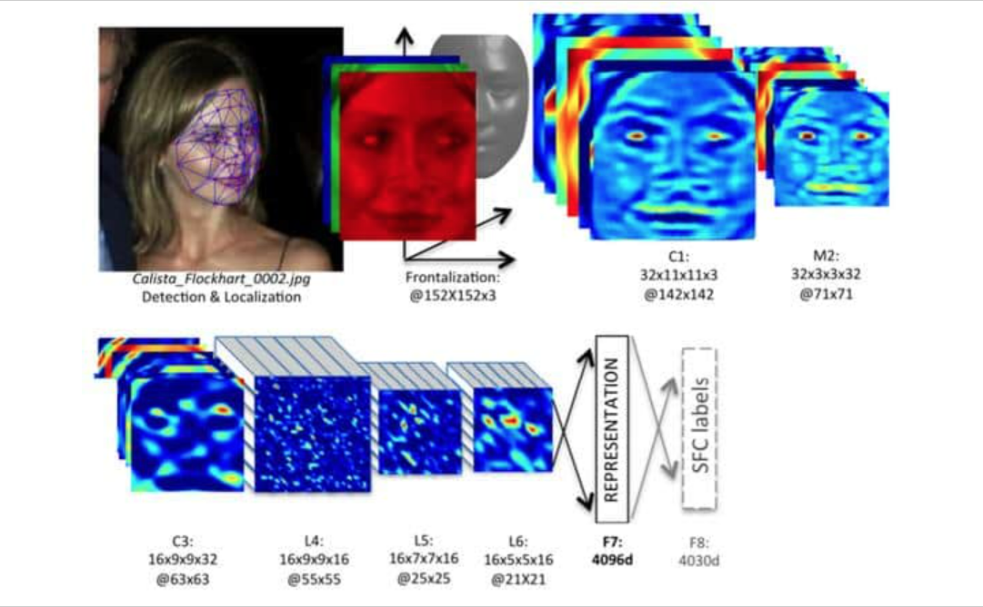
DeepFace
(Phase 2)

Slide 11

Technology allows social media companies to create their digital profiles

Slide 12
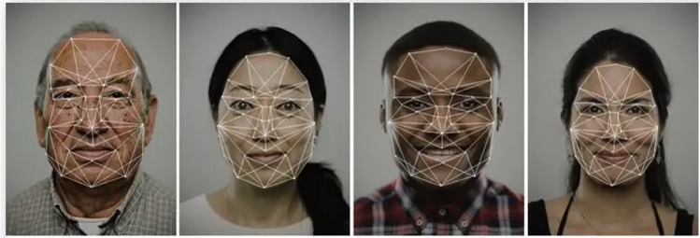
The accuracy was much lower when the algorithms are pled to women, black individuals, and young people, because algorithms are primarily trained with white men.

Slide 13
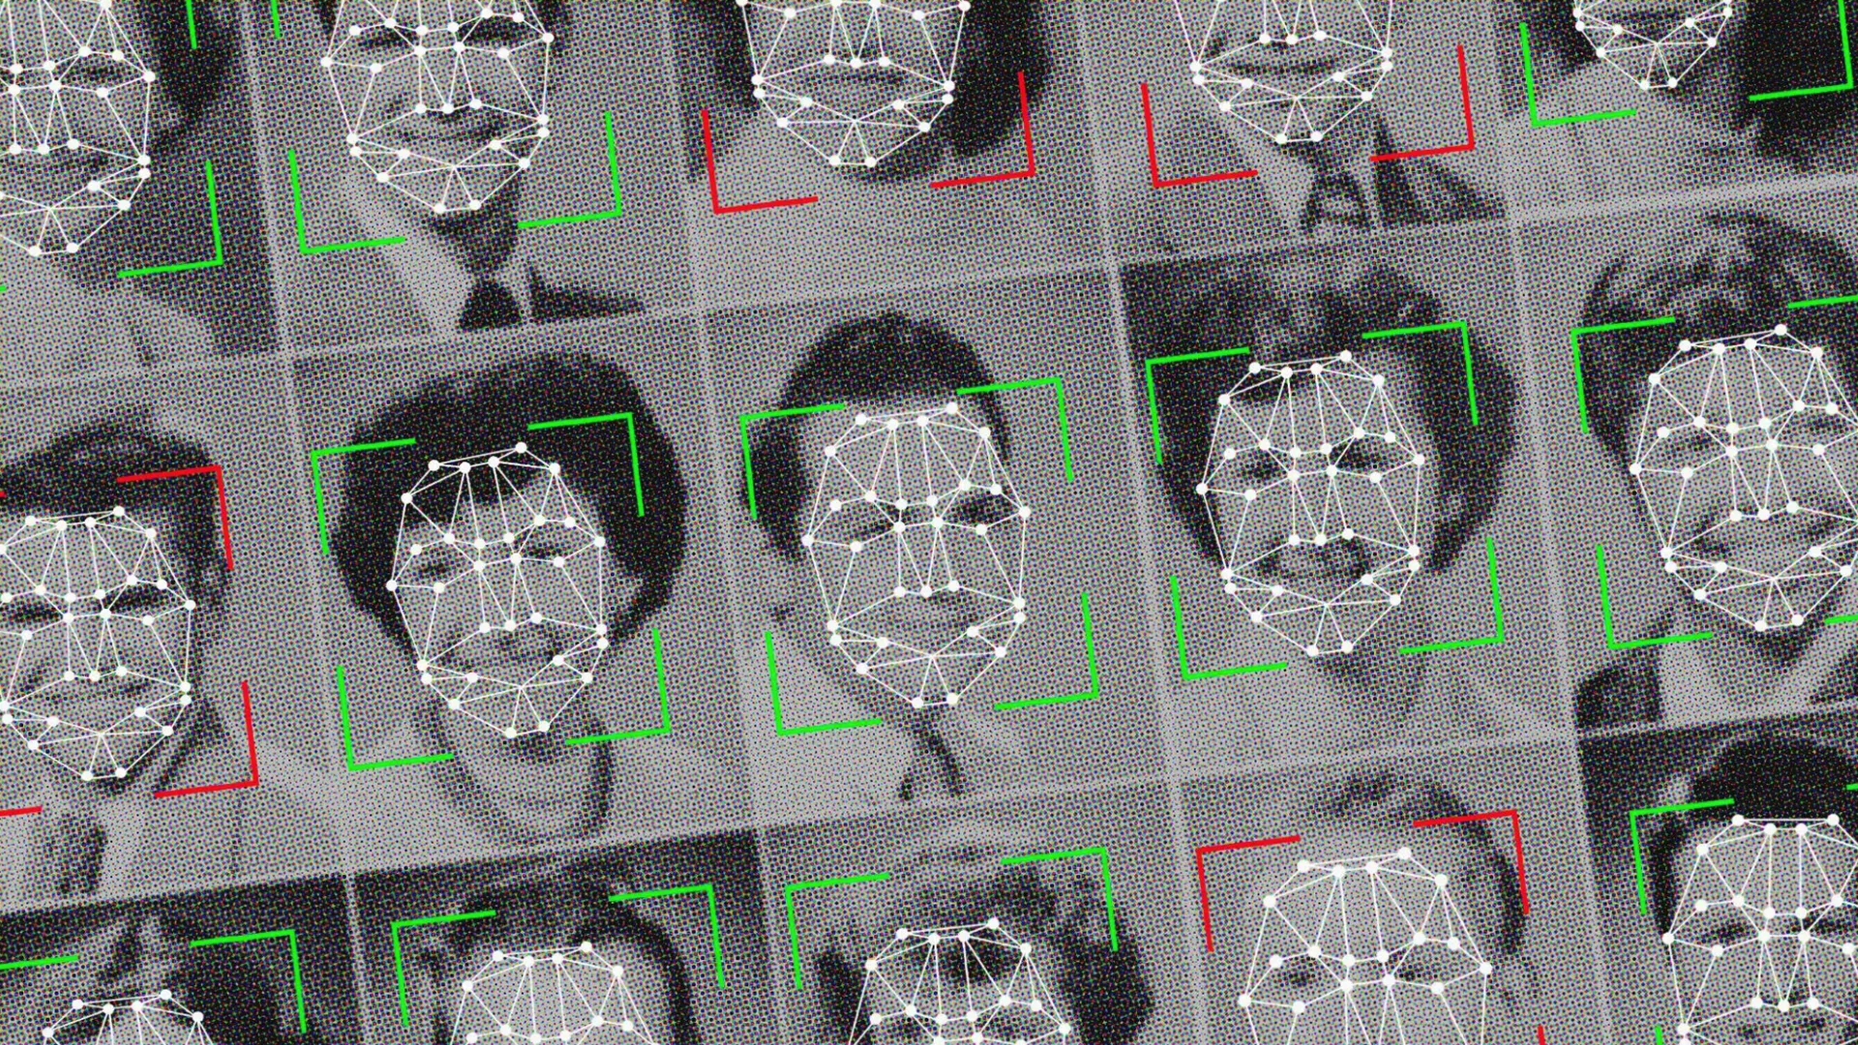

Shut down Facebook facial recognition system

